Slide 1

SMART SHOPPING TROLLEY WITH AUTOMATED BILLING USING ARDUINO UNO
Team Member Details
Team name : Solvix
Team Members :
Arokiya Nithish. J
Ishwarya. M
(Vel Tech University)
Domain : Smart Automation
Theme : Smart Retail / Intelligent Shopping
Date : 28/05/2025

Slide 2
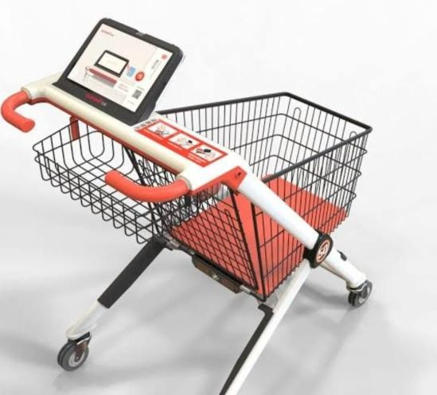
ABSTRACT :
The Smart Shopping System using RFID is a cost-effective prototype designed to revolutionize the retail shopping experience. In this system, an RFID reader (RC522) is connected to an Arduino Uno to read multiple RFID cards, each representing a unique product. Upon scanning a card, the system identifies the item using its UID and displays the product’s name and status on an LCD screen equipped with an I2C module. This approach aims to minimize manual intervention in billing and streamline the checkout process. The project demonstrates how automation and contactless identification can enhance customer satisfaction while reducing time spent in queues. It eliminates the need for barcodes and manual scanning, and can be scaled further to include features such as cost calculation, cart tracking, and centralized billing. This project not only improves shopping convenience but also provides retailers with a tool to manage inventory in real-time.

Slide 3
EXISTING SYSTEM:
The existing shopping system relies on manual barcode scanning at checkout counters, leading to long queues and delays. Some smart trolleys use barcode scanners, but they require customers to scan items manually, which can be inconvenient and error-prone. RFID-based trolleys offer automated billing by detecting products with RFID tags, but they face challenges such as high costs, tagging difficulties, and security concerns. Additionally, some systems depend on network connectivity, which may not always be reliable. To address these issues, an improved Arduino-based smart trolley with RFID, weight sensors, and automated billing can enhance efficiency, security, and customer convenience.

Slide 4
PROBLEMS/ SOLUTIONS:
Problem: Difficulty in scanning barcodes or RFID tags due to poor placement or damage Solution: Implement multi-angle scanners or image recognition to detect items automatically, reducing reliance on barcode positioning
Problem: Incorrect price calculations or duplicate billing can frustrate customers
Solution: Use AI-driven error detection and allow user to review nd confirm purchases before payment
Problem: Customers may be concerned about data collection and misuse
Solution: Implement strict data encryption, provide transparent privacy policies,and offer
pot-in/pot-out features for data tracking

Slide 5
PROPOSED SYSTEM:
The proposed smart shopping trolley using Arduino aims to improve the shopping experience by automating the billing process and reducing checkout time. The trolley is equipped with an Arduino microcontroller, an RFID reader, a LCD display or touchscreen, and a Bluetooth or Wi-Fi module for communication. When a customer places an item in the trolley, the RFID reader scans the product tag, and the system automatically adds the item to the bill. The total price is displayed in real-time on the LCD screen, allowing the customer to keep track of their expenses. To enhance security, a weight sensor can be integrated to verify that all scanned items are placed inside the trolley, preventing theft or billing errors. Additionally, a navigation system can be included to help customers locate products efficiently. Once shopping is completed, the total bill is generated, and payment can be made via a mobile app or digital payment gateway, eliminating the need for long queues at the checkout counter. The trolley can also be linked to the store’s security system to detect any unscanned items, triggering an alert if needed. This system significantly reduces manual billing errors, enhances customer convenience, and improves store security, making the shopping experience faster and more efficient.

Slide 6
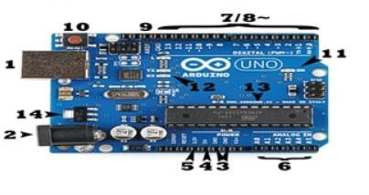
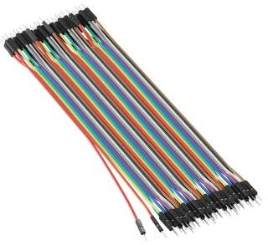
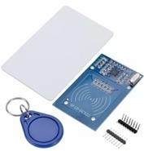
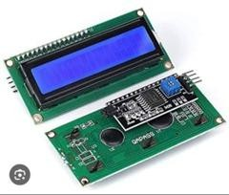
MATERIALS:
ARDUINO dip:
The Arduino uno is a popular microcontroller development board that serves as an excellent
starting point for electronics and programming enthusiasts
Jumper Wires:
Jumper wires are essential components in electronic prototyping. Jumper wires, also known as DuPont wires, are electrical wires with connector pins at each end. They allow you to connect two points in a circuit soldering
RFID Module:
It’s designed for contactless communication at 13.56 MHz and is commonly used for reading and
writing data to RFID tags
LCD Display:
Shows the name or ID of each item as it’s scanned via RFID. Display the price of the current item
being added to the cart

Slide 7
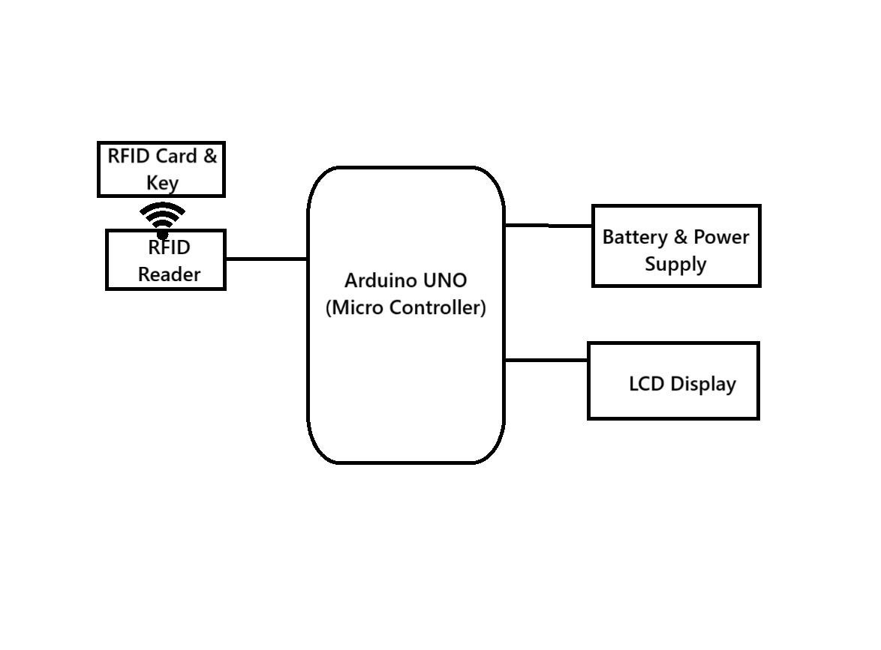
BLOCK DIAGRAM :

Slide 8
HARDWARE PROTOTYPE:
Arduino – Brain of the system.
RFID Reader – Scans products with RFID tags.
Load Cell (Weight Sensor) – Checks the weight of items.
LCD Display – Shows item names and prices.
Buzzer – Beeps on scan or error.
Battery/Power Bank – Powers the system.
Wi-Fi Module (Optional) – Sends bill to mobile or cloud

Slide 9
SOFTWARE DETAILS:
LCD Display UI – Simple display to show items and bills
Product Scanning – Scan items using barcode or RFID.
Auto Billing – Adds prices and shows total automatically.
Inventory Update – Stock updates when items are added.
Data Storage – Keeps history of purchases
Arduino IDE – Used for writing, compiling, and uploading the code to the Arduino Uno.
C/C++ (Embedded C) – Programming language used in the Arduino sketch.
RFID Library (MFRC522) – Library for interfacing the RC522 RFID reader with Arduino.
LiquidCrystal_I2C Library – Used to control the I2C-enabled LCD display.
Serial Monitor – Used for debugging and viewing output from the Arduino during development.

Slide 10
WORK SCHEDULE :
The working principle of the Smart Shopping System is based on the RFID Technology and microcontroller-based automation. The RFID module(RC522) user radio frequency signals to defect and read the UID of RFID cards. When a customer brings a card near the reader, the module reads the UID and sends this data to the Arduino Uno via the SPI communication protocol. The Arduino process the UID and compares it against predefined values in the code. Each UDI corresponds to a particular product, like ”Milk”, ”Bread”, or “Juice”. Once identified the Arduino commands the LED display(connected via 12c) to show the product name and a confirmation message like “Purchased”. This real-time response is achieved through efficient polling of the RFID reader in the main loop ,making the system reactive and user-friendly. No internet connection is required, making it ideal for standalone, offline retail applications. Additionly, the modular design allows new feactures to be added, such as total cost calculator, Wifi connectivity for inventory syncing, or intergrating with e-wallets. Thus, the system leaveages the contactless and quick-read nature of RFID to provide a smooth and intelligent shopping experience, minimizing human involvement and maximizing automation

Slide 11
ADVANTAGES:
1.Speed
up checkout with automated billing
real time
2.Shows
total cost to help with budgeting more convenient and user-friendly
3.Makes shopping
Reduces the need for many cashiers (lower labour cots)
Helps stores track inventory more accurately
DISADVANTAGES:
High cost to develop and maintain the system
Risk of technical issues or system failures 3.Increased changes of theft or billing errors
Raises privacy concerns for some users
Difficult for elderly or non-tech-savvy customer to use

Slide 12
REFERENCES:
Machhirke, K., Goche, P., Rathod, R., Petkar, R. and Golait, M., 2017. A new technology of smart shopping cart using RFID and ZigBee. International Journal on Recent and Innovation Trends in Computing and Communication, 5(2), pp.256-259.
Chandrasekar, P. and Sangeetha, T., 2014, February. Smart shopping cart with automatic billing system through RFID and ZigBee. In International Conference on Information Communication and Embedded Systems (ICICES2014) (pp. 1-4). IEEE.
Ali, Z. and Sonkusare, R., 2014, August. RFID based smart shopping: an overview. In 2014 international conference on advances in communication and computing technologies (ICACACT 2014) (pp. 1-3). IEEE.
Shahroz, M., Mushtaq, M.F., Ahmad, M., Ullah, S., Mehmood, A. and Choi, G.S., 2020. IoT-based smart shopping cart using radio frequency identification. Ieee Access, 8, pp.68426-68438.
https://youtu.be/7zR-OuZuCUM?si=c2kP76Z5N3Yyzy42

Slide 13


